Slide 1
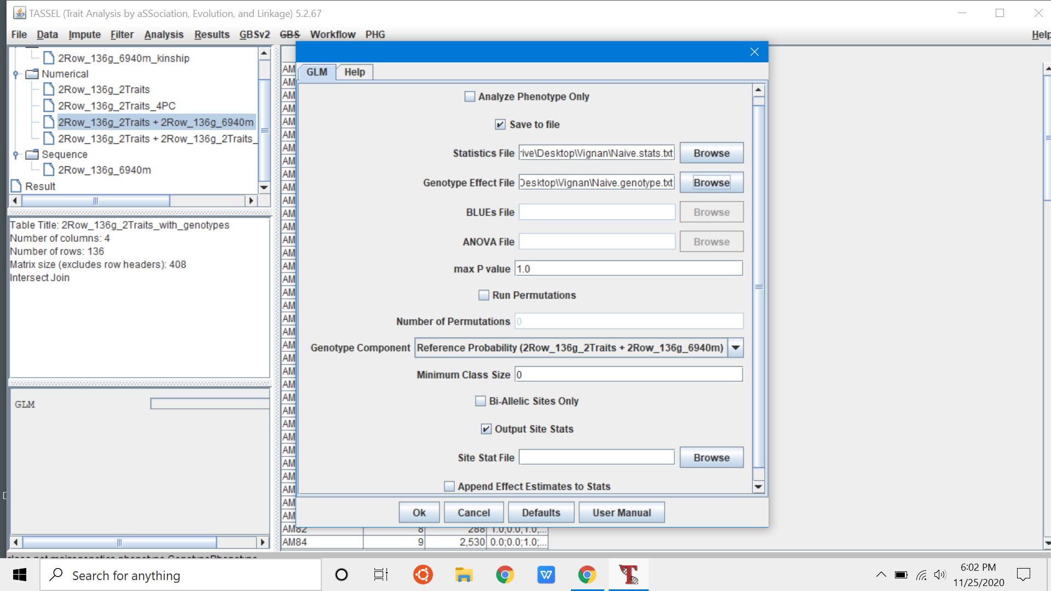
Save to file - On
Names for statistics file and Genotype effect file
Hit “Ok”

Slide 2
AM IN TASSEL
Sujan Mamidi

Slide 3
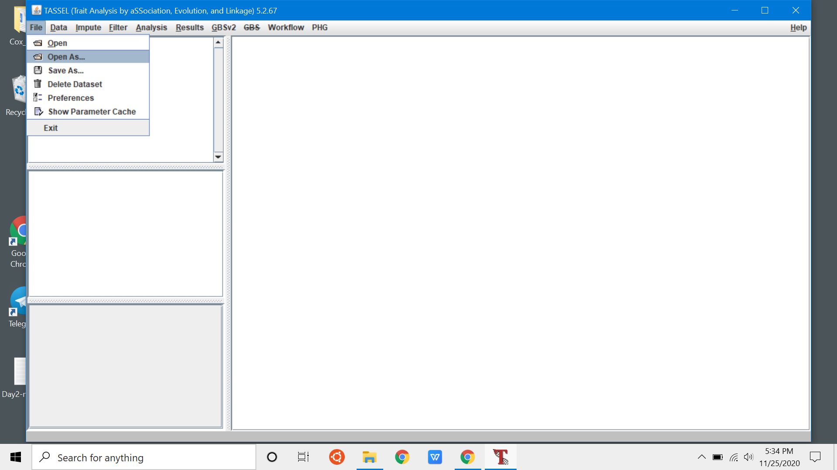
File/Open As

Slide 4
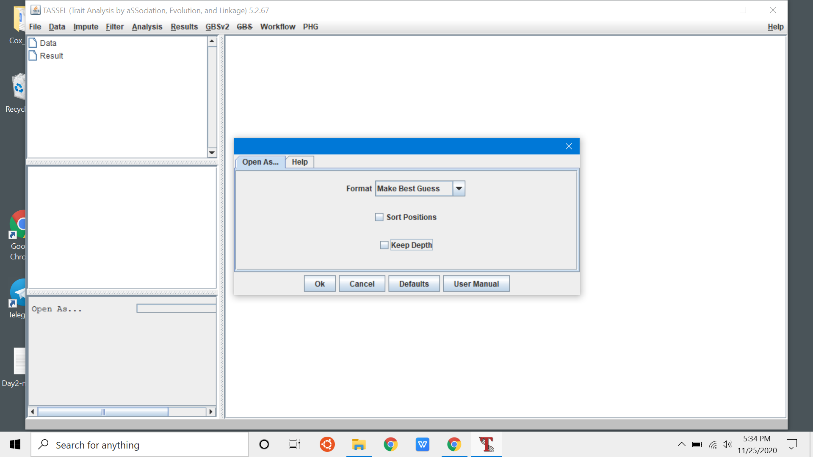
Make Best Guess

Slide 5
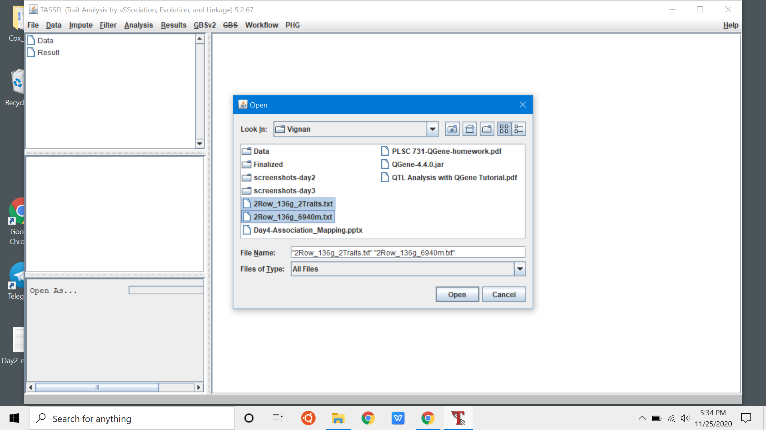
Select Multiple Files - Phenotype & Genotype

Slide 6
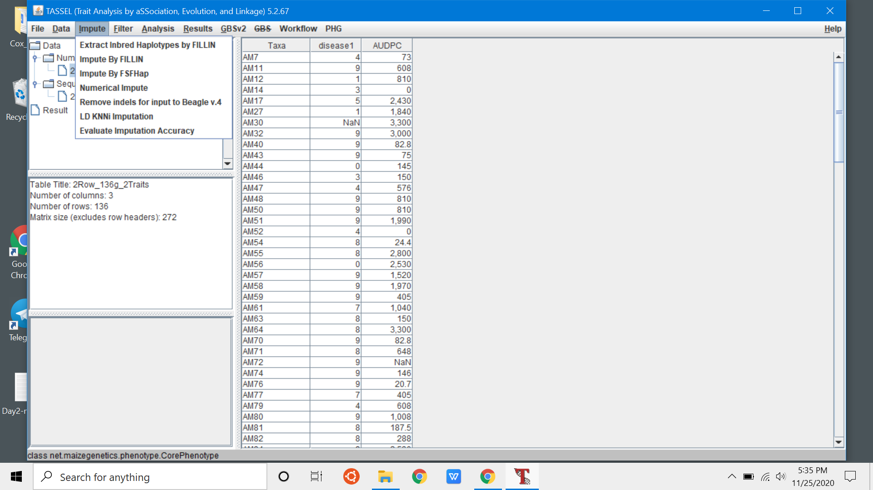
Phenotype File - Information
Impute Missing phenotype
Impute Missing Genotype

Slide 7
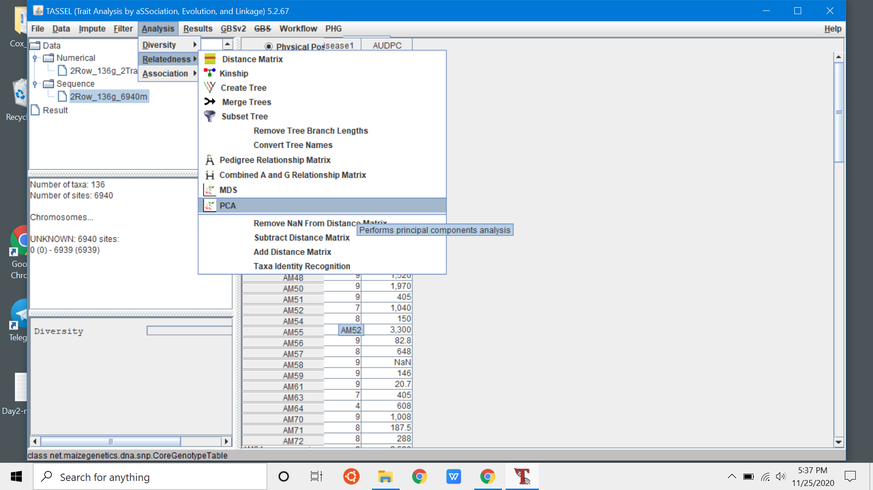
Analysis/Relatedness
PCA

Slide 8
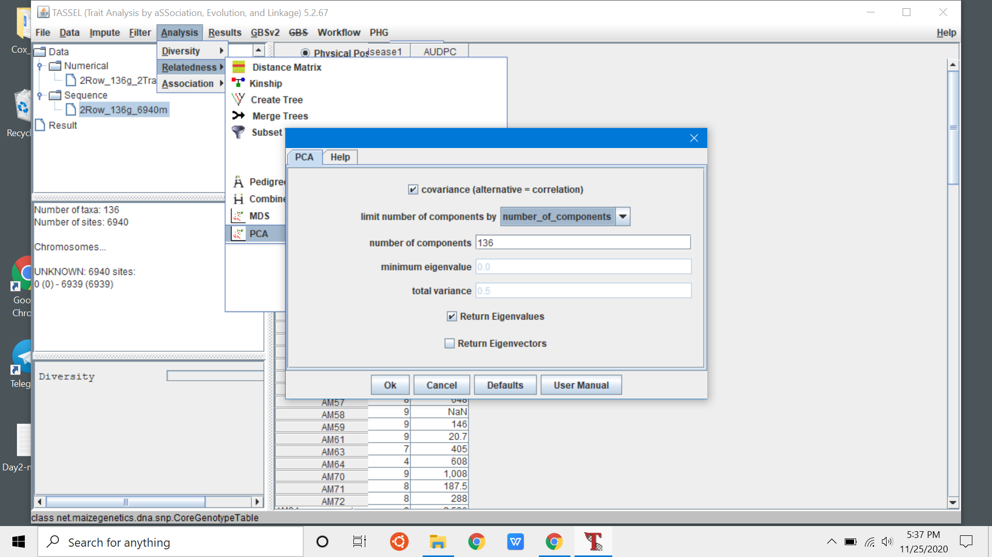
Set “number of components” to 10
Return Eigen values

Slide 9
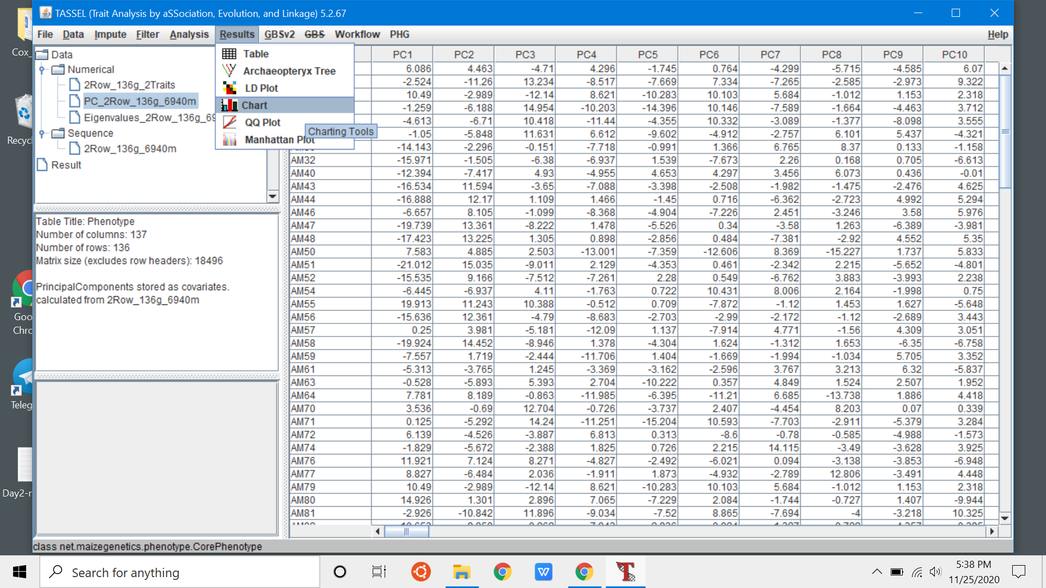
Results/Chart

Slide 10
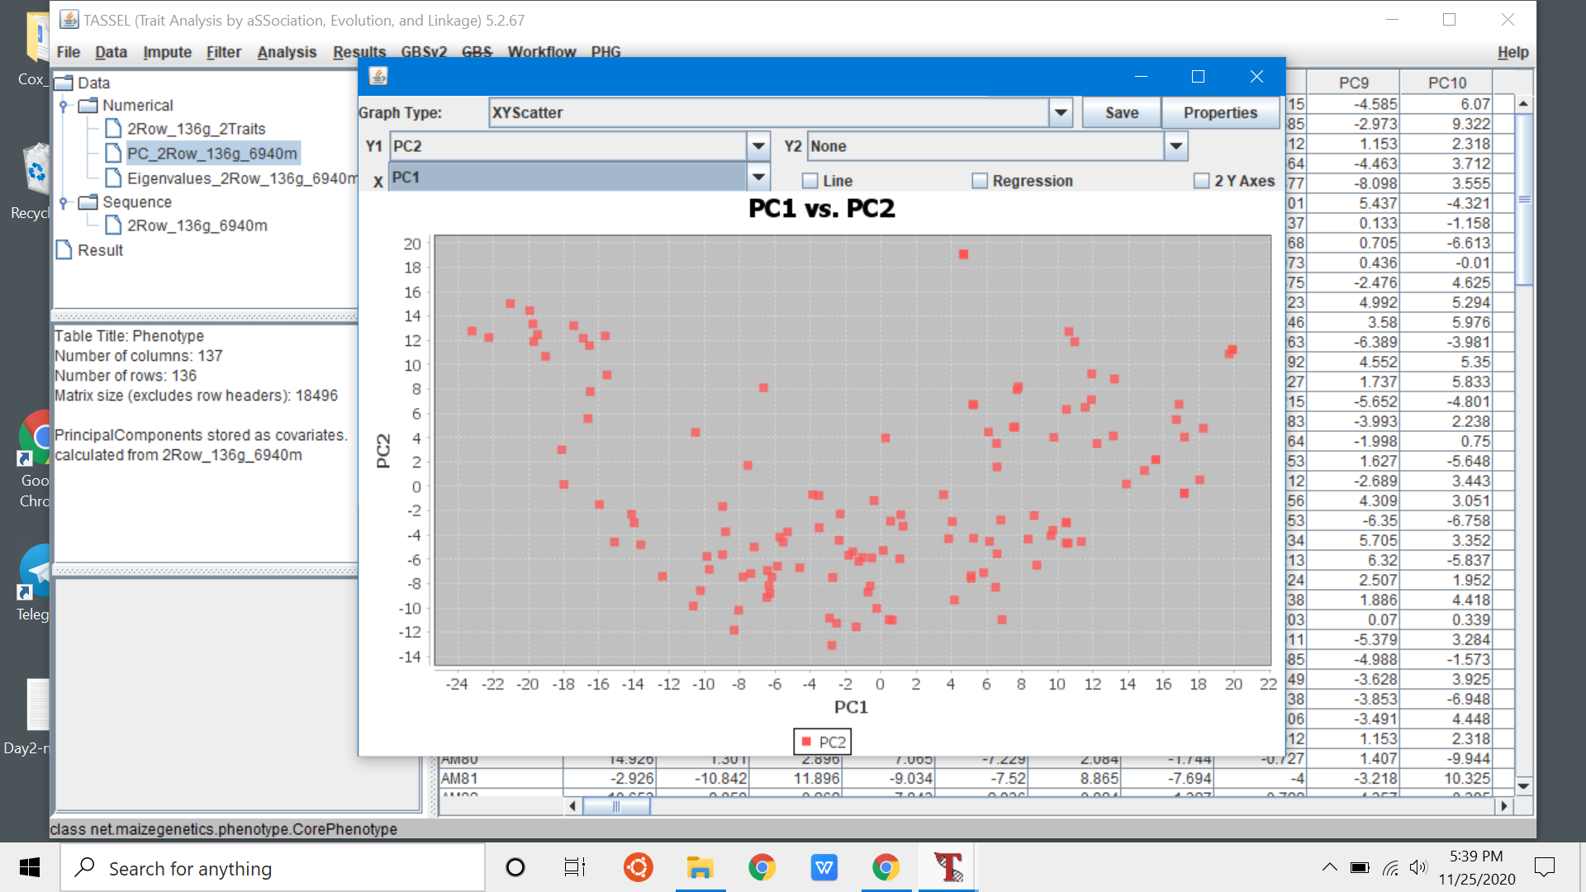
PC Plot to understand population structure

Slide 11
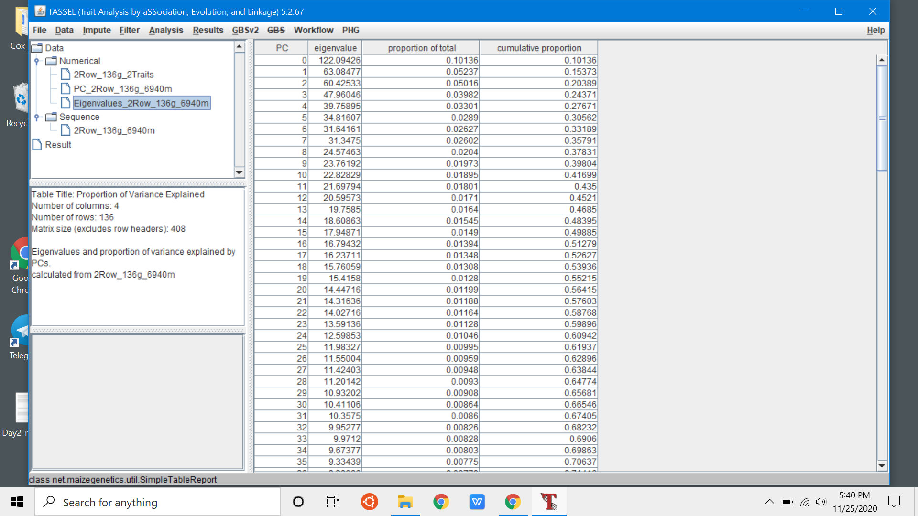
PCA Eigen values - look for cumulative proportion

Slide 12
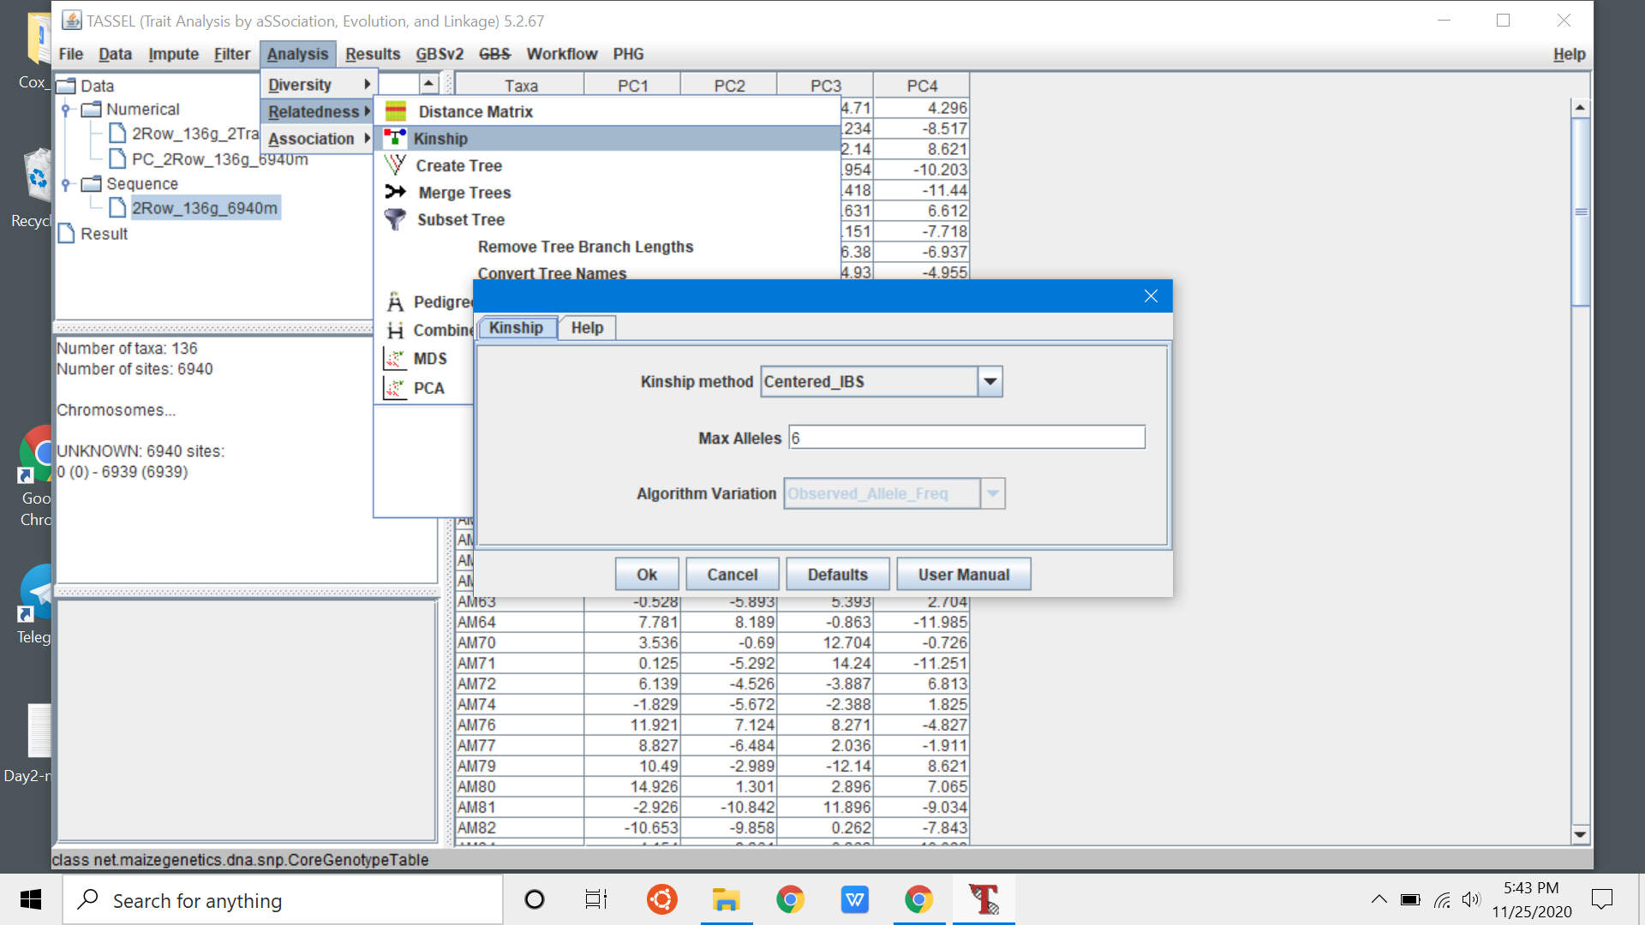
Analysis/Kinship - Leave defaults

Slide 13
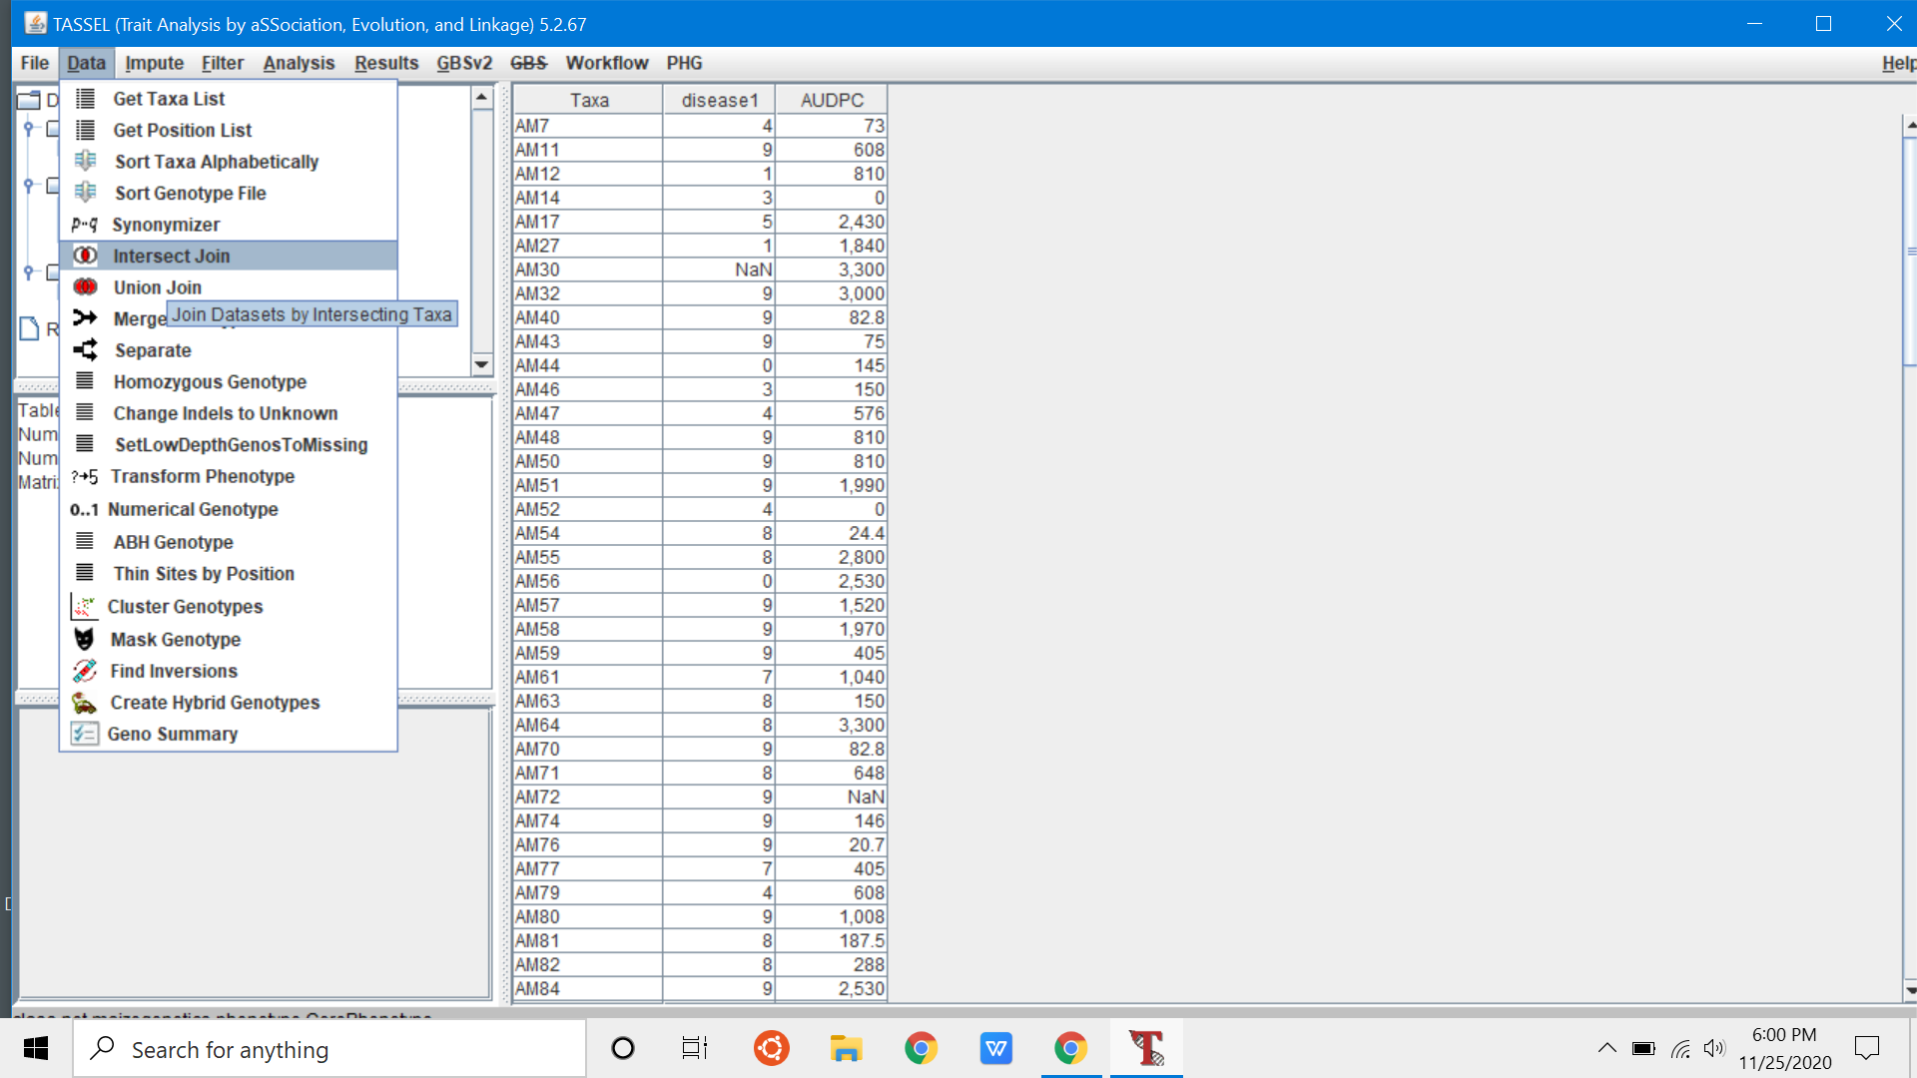
select Phenotype and genotype files
data/intersect join - rename as “Naive”

Slide 14
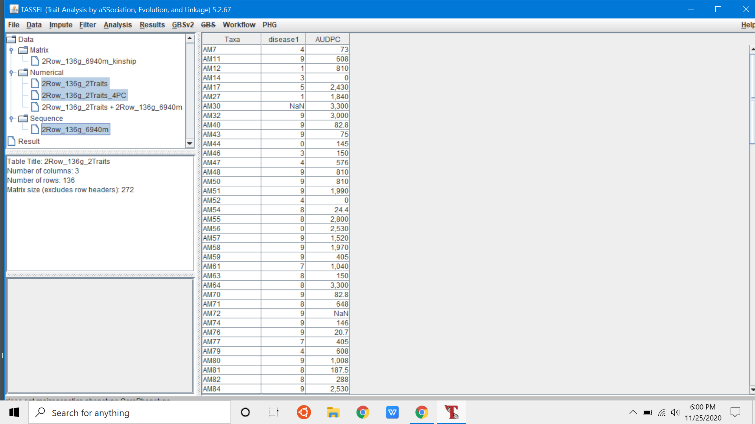
select Phenotype, genotype and PCA file
data/intersect join - rename as “PC4”

Slide 15
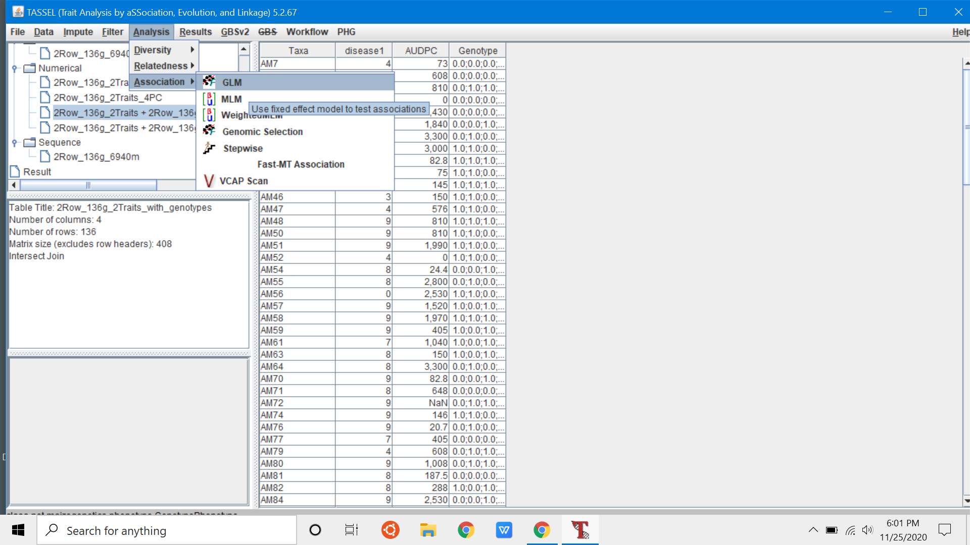
Select “Naive” data
Analysis GLM

Slide 16
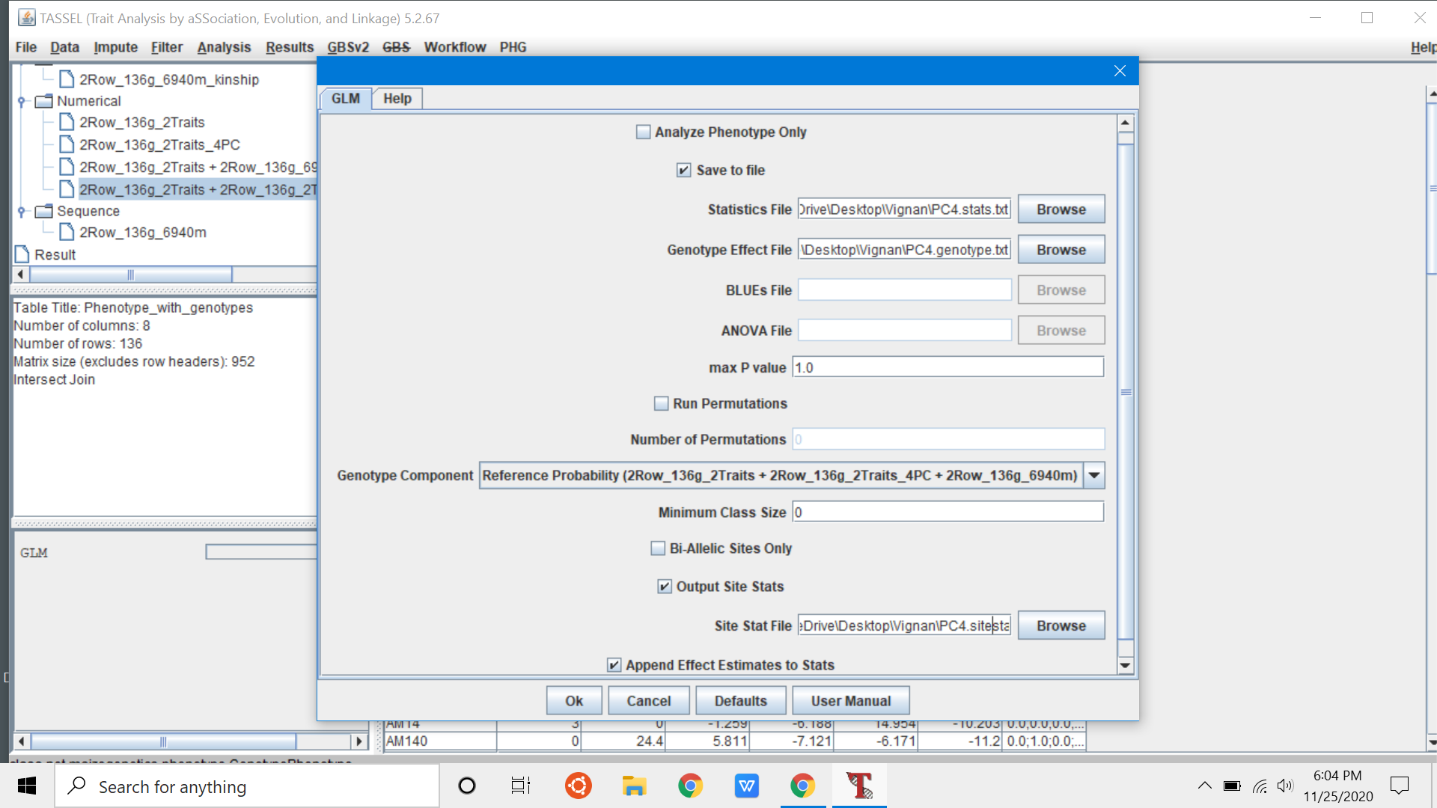
Select “PC” data
Analysis GLM

Slide 17
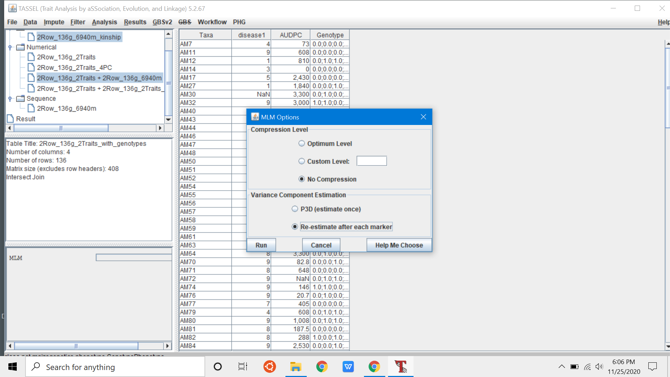
Select “Naive” + kinship
Analysis MLM
“No Compression”
“Re-estimate after each marker”
“Run”
Repeat with “PC4” + kinship

Slide 18
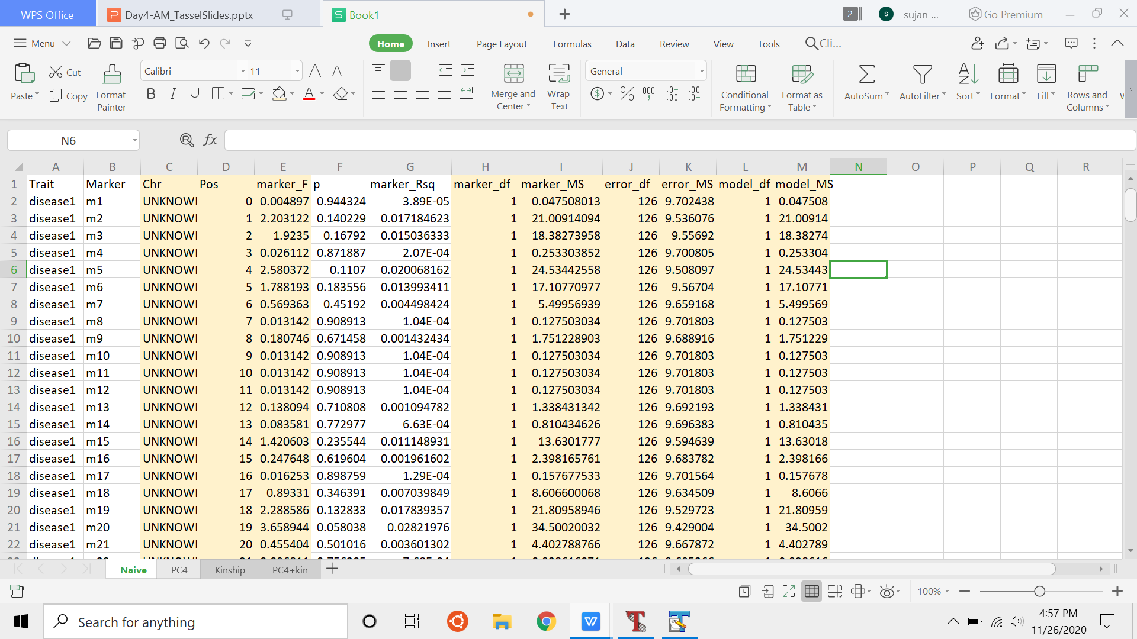
Copy results to Excel - All 4 Models
Highlighted columns - remove

Slide 19
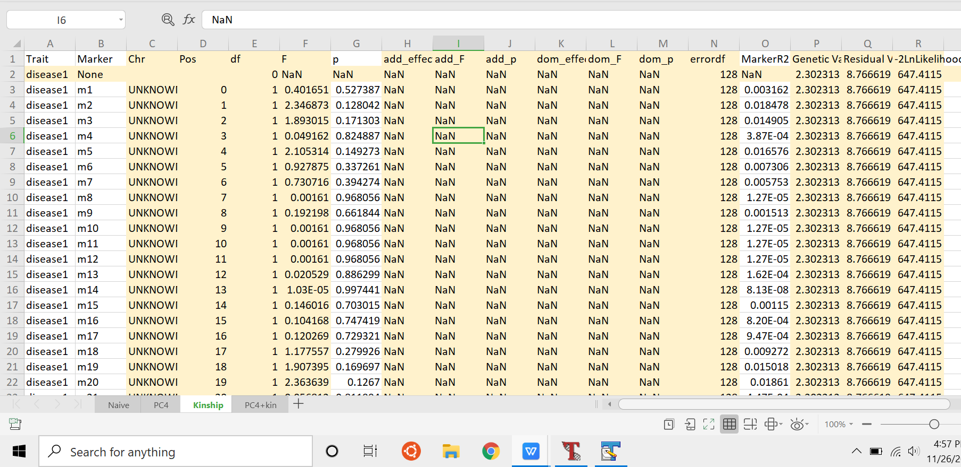
Kinship model
Remove highlighted columns

Slide 20
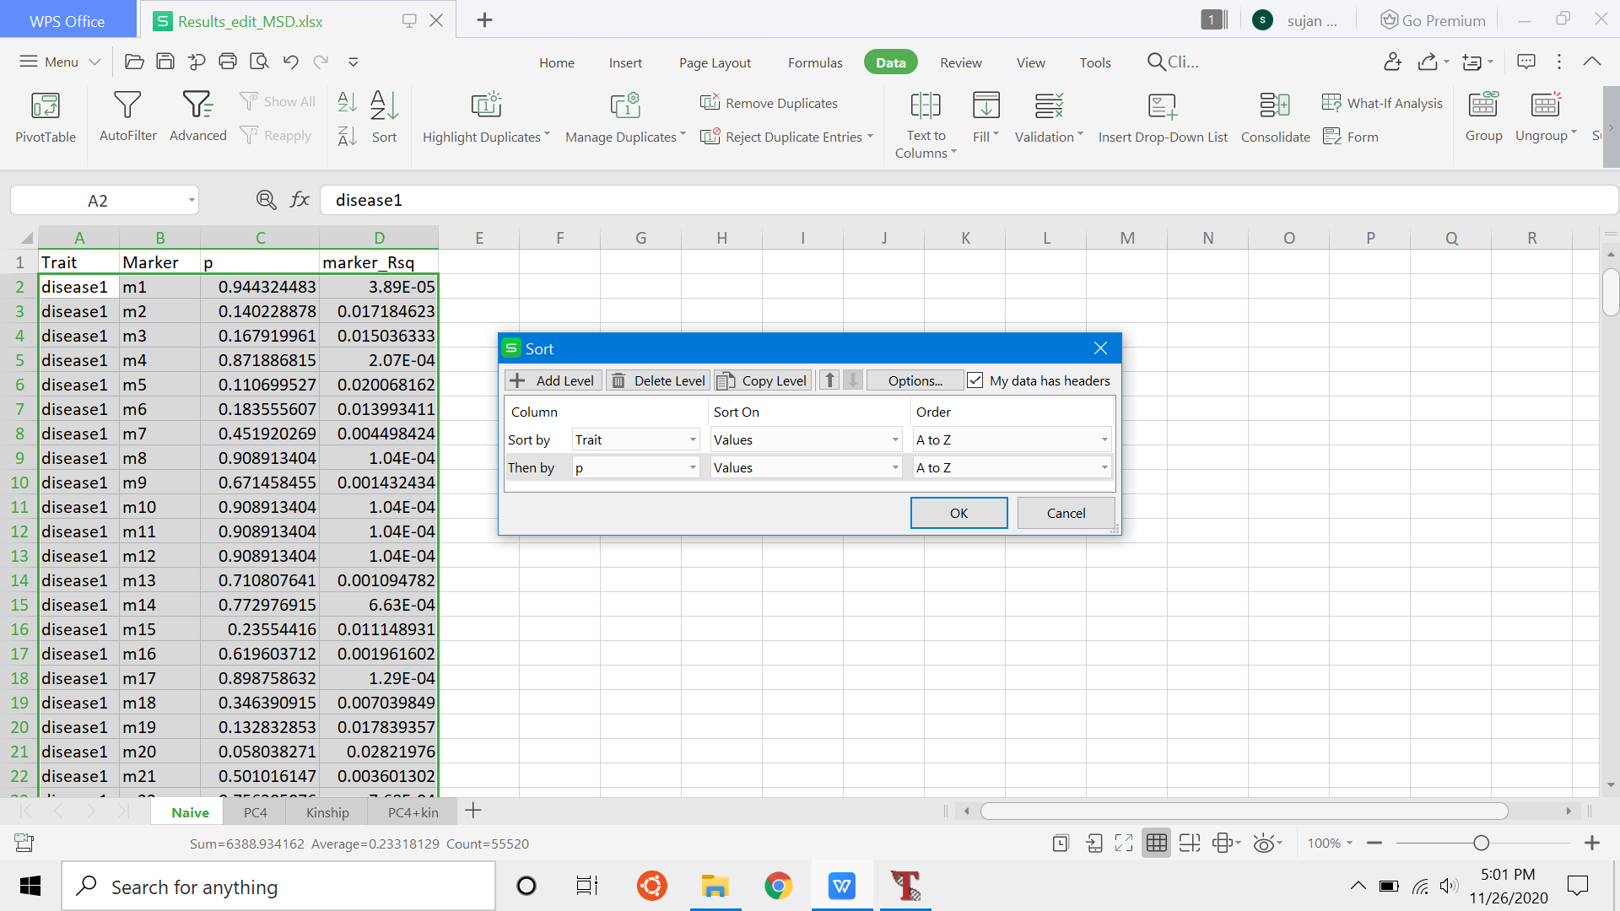
Sort by Trait and then “p”

Slide 21
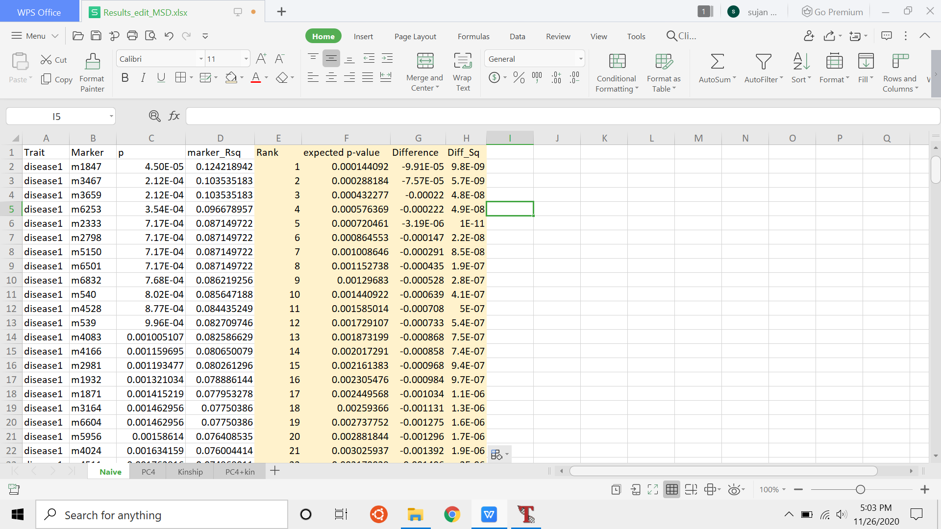
Make 4 columns
Rank - 1.2.3...n
expected p-value = Rank/# of markers
Difference = p- expected pvalue
Diff_sq = Difference²

Slide 22
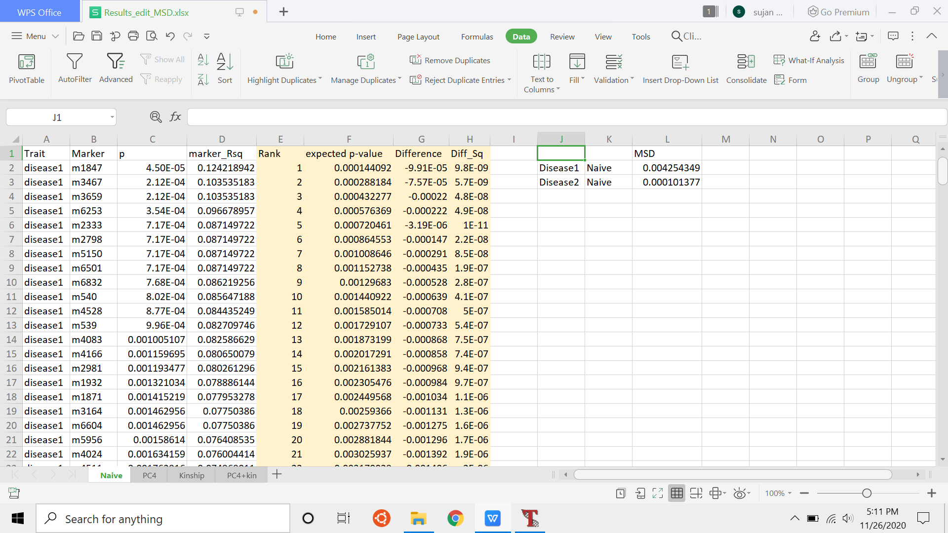
MSD - Calculate mean of Diff_sq - for each trait

Slide 23
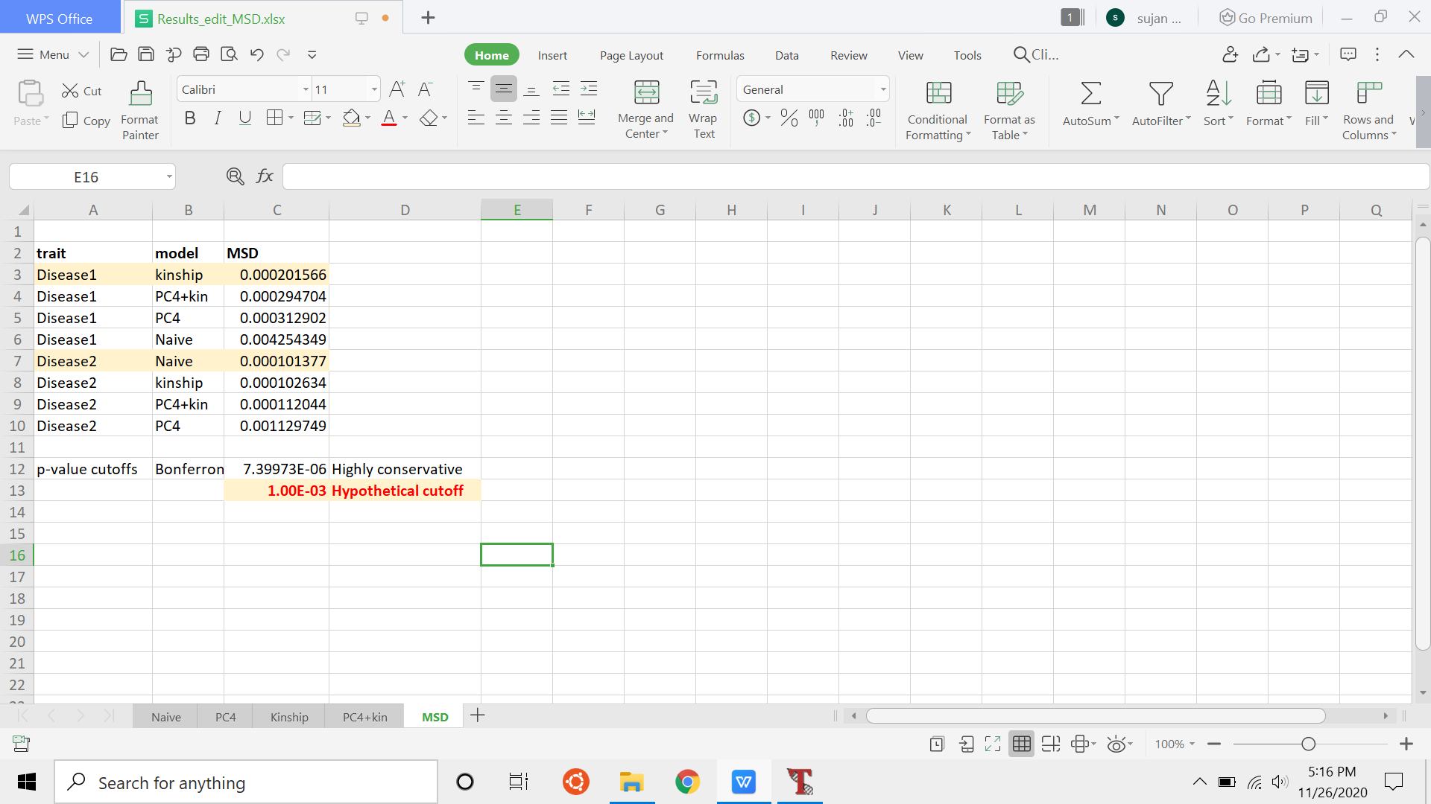
Sort by Trait and MSD
decide on a p-value
Bonferroni
FDR/pFDR
cutoff value
Bootstraps

Slide 24
Open Effect file to get Marker Effects

Slide 25
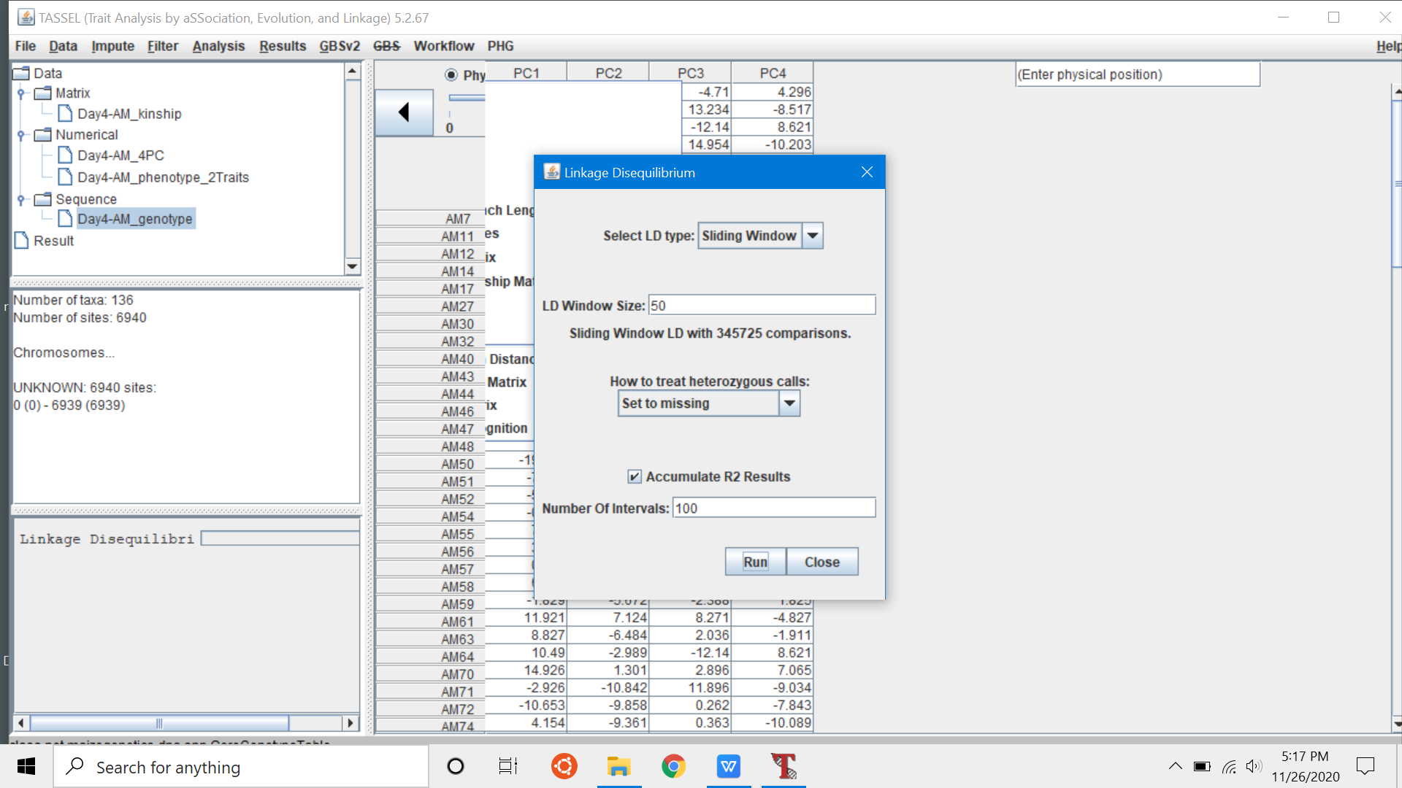
Calculate LD

Slide 26
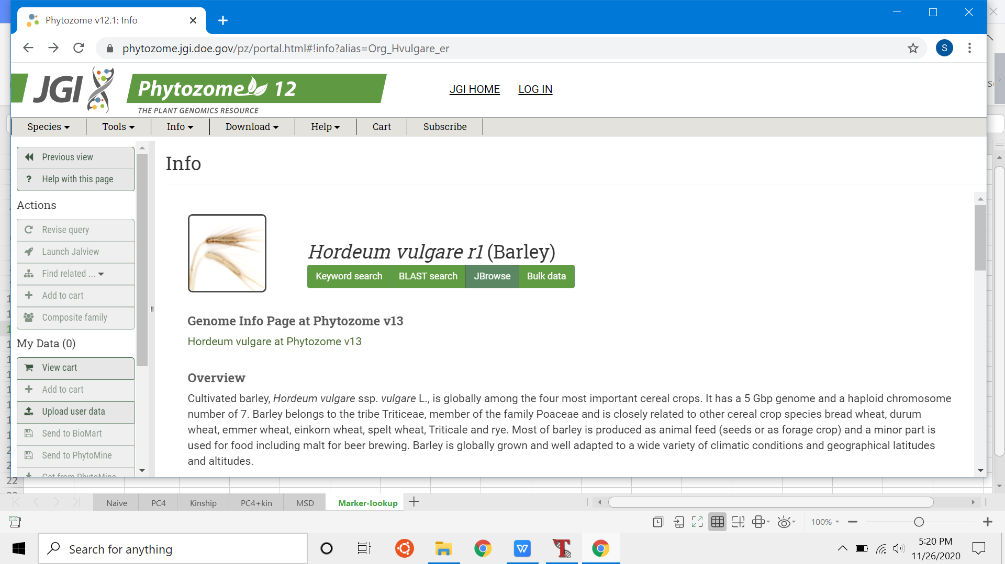
Phytozome - Jbrowse for species

Slide 27
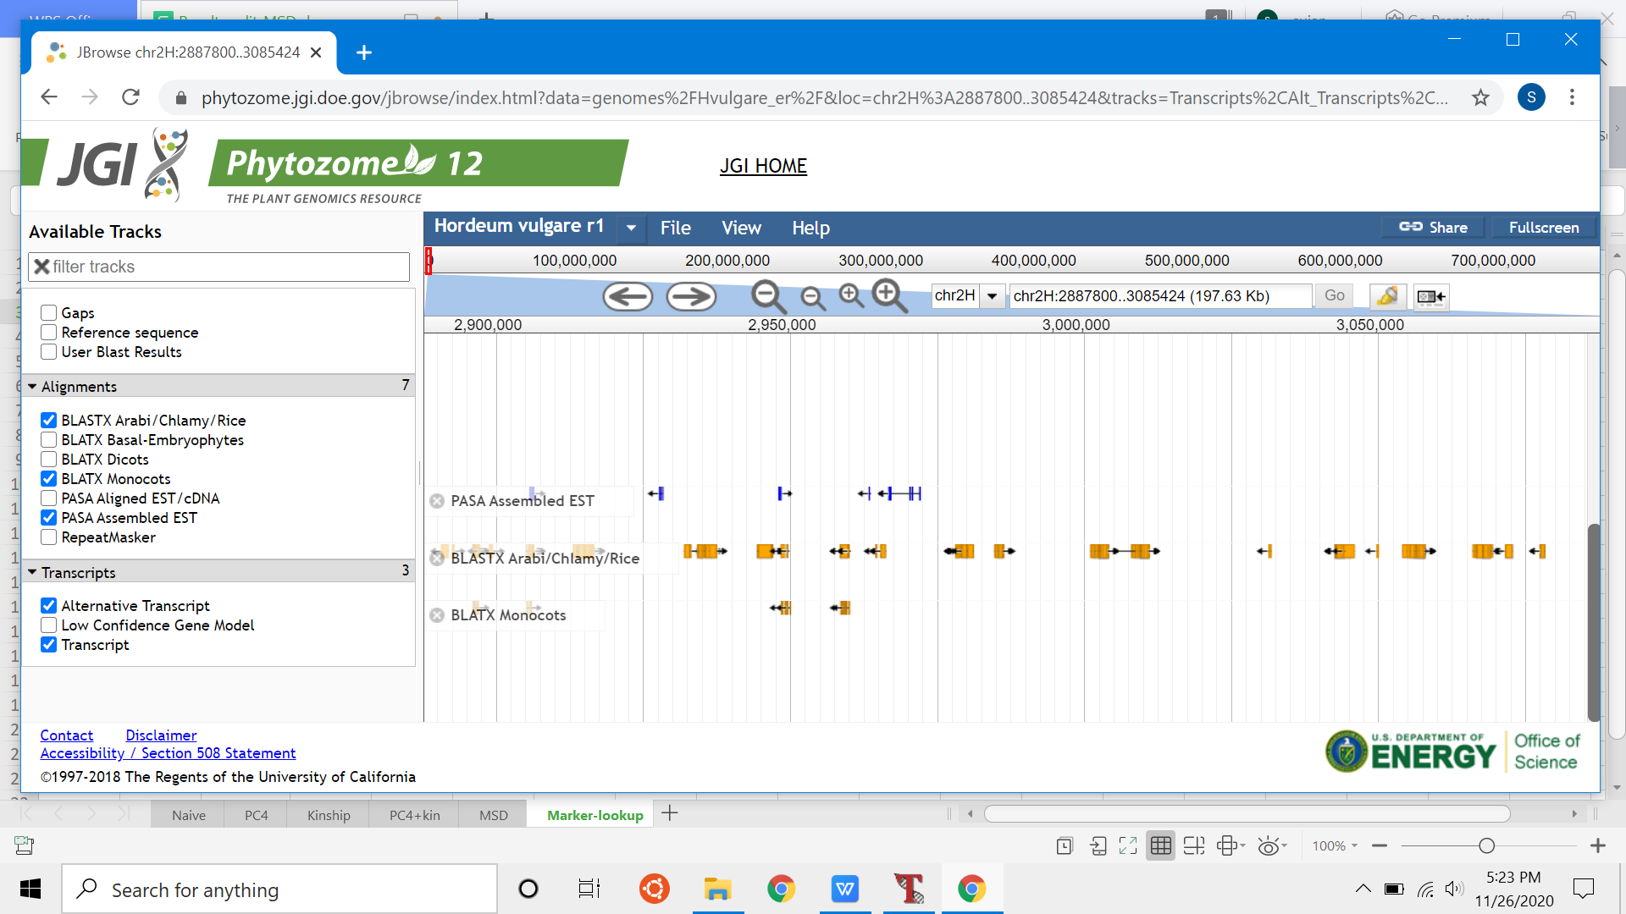
100kb on either side of marker position

Slide 28
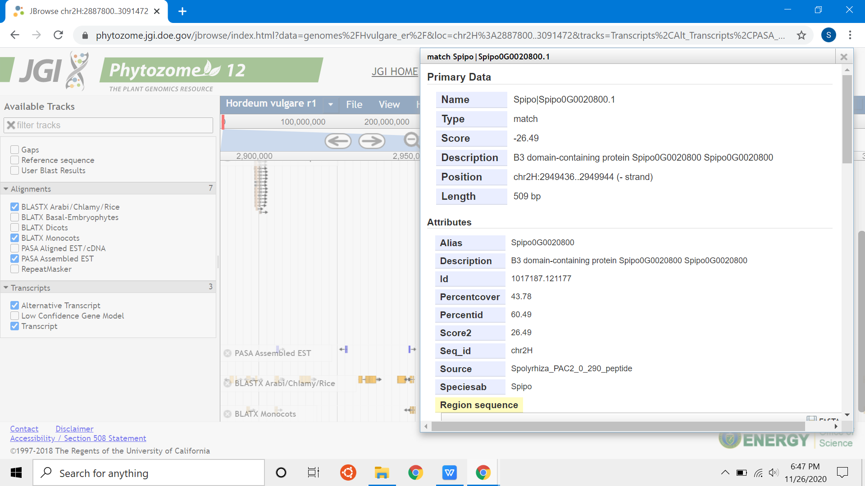
Gene description

